Slide 1
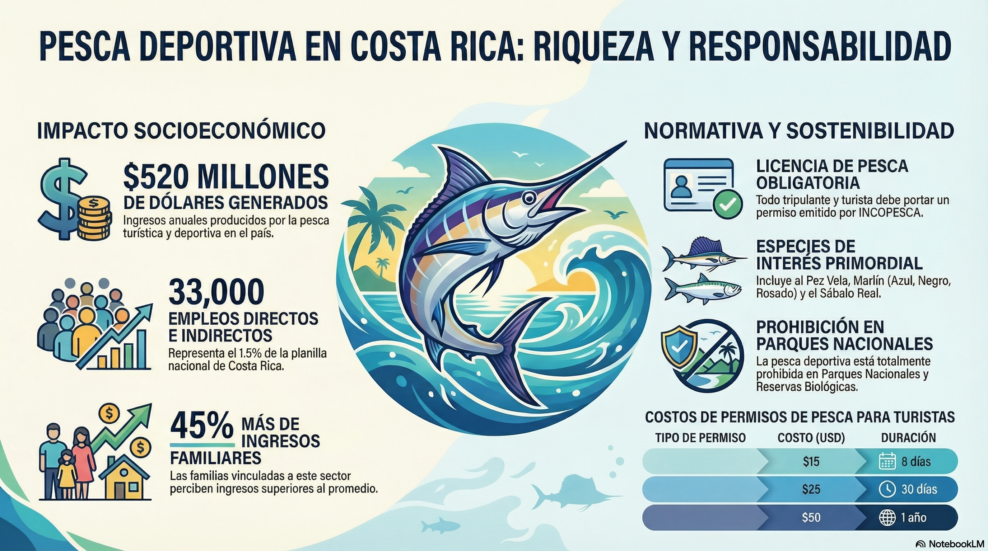

Marín Sandoval, Henry. Best Practices Guide for Tourist and Sport Fishing in Costa Rica / authors Henry. Marín Sandoval and Fresia Villalobos Rojas; FECOP, MarViva, with the collaboration. of the Inter Institutional Commission on Marinas and Tourist Piers and the Costa. Rican Tourism Institute, San José, Costa Rica : FECOP, 2023. 54 pages, color illustrations, color photographs, PDF.
ISBN 978-9930-611-22-7

